Slide 1
A MultiModal Colorization App
Computer Vision Project
Teacher: Luigi Cinque, Marini
Student: Riccardo Scuto 2125102

Slide 2
Starting Paper
The paper “Control Color: Multimodal Diffusion-based Interactive Image Colorization “[1] introduces CtrlColor, a novel multi-modal image colorization framework based on the pre-trained Stable Diffusion model, designed to address several limitations present in existing colorization methods.
These limitations include lack of user interaction, inflexibility in local colorization, unnatural color rendering, insufficient color variation and color overflow.
The CtrlColor framework is distinctive for its ability to unify various colorization tasks—unconditional, prompt-based, stroke-based, and exemplar-based colorization—within a single framework, leveraging the rich priors encapsulated in SD's latent diffusion model.

Slide 3
Key Features
Highly Controllable Multi-modal Colorization: Supports various colorization modes (prompt-based, stroke-based, exemplar-based, and their combinations) for both local and global color adjustments.
Addressing Color Overflow and Incorrect Color Issues: Incorporates training-free self-attention guidance and a learned content-guided deformable autoencoder to tackle color overflow and inaccuracies.
User Strokes for Local Color Control: Introduces a novel method for precise local color manipulation through user strokes, encoded directly into the diffusion process.
Leverage of Pre-trained SD Model's Advantages: Utilizes the SD model's rich color variation and quality to produce superior colorization results compared to existing methods.

Slide 4
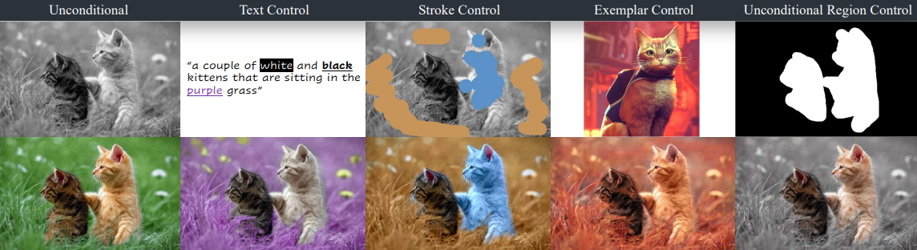
CtrlColor Modes

Slide 5
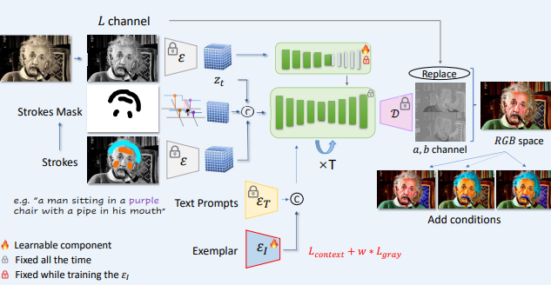
The framework's architecture integrates user inputs (e.g., strokes, exemplars) and text prompts into the colorization process, using self-attention and deformable convolution layers to mitigate color overflow and ensure color accuracy. This design enables precise control over the colorization output, allowing for highly customizable and natural-looking images.
The main structure of CtrlColor Model achieves multi-modal controllable colorization by blending controls from diverse components.

Slide 6
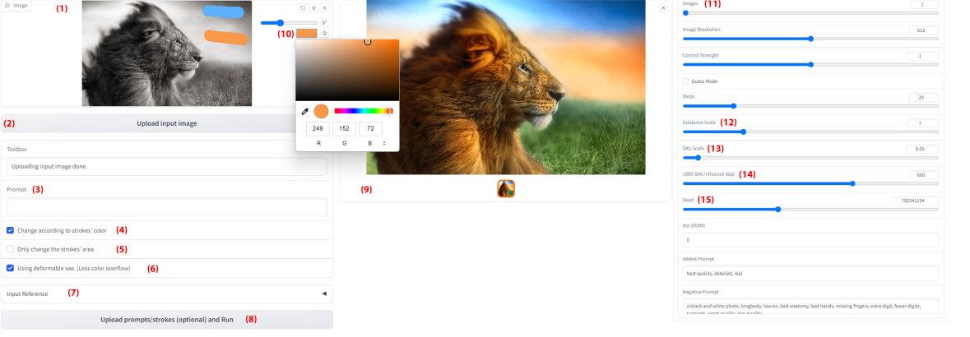
The interactive interface of our CtrlColor
CtrlColor represents a significant advancement in image colorization technology, providing a versatile and effective tool for achieving highly controllable and aesthetically pleasing colorizations. Its innovative use of the SD model, combined with novel color control mechanisms, addresses longstanding challenges in the field, opening new possibilities for creative and practical applications of image colorization.

Slide 7
Colorization App
The goal of the project was to create a program capable of coloring black and white images and videos and saving the converted versions. The program consists of three coloring modes:
- Automatic colorization
- Dot Colorization
- Palette Colorization

Slide 8
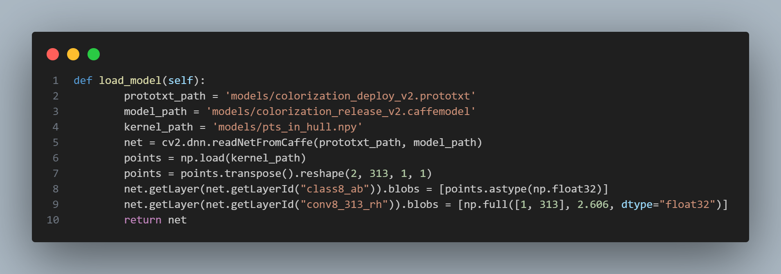
Automatic colorization
Automatic colorization uses deep neural networks and machine learning to predict and apply realistic colors to a grayscale image.
Is based on a pre-trained model known as Colorful Image Colorization published by Zhang[2] et al. in 2016. The model is trained on millions of images to learn correlations between an image's luminance (brightness or grayscale information) and its corresponding color.

Slide 9
Automatic colorization
Model Loading: The pre-trained model with weights (colorization_release_v2.caffemodel) and network configuration (colorization_deploy_v2.prototxt) is loaded. Additionally, a set of anchor points (pts_in_hull.npy) representing ab cluster centers in the Lab color space is loaded. These points assist the network in normalizing the color output.
Image Pre-processing: The black and white image is pre-processed to fit the network's input requirements. This involves converting it to grayscale, normalizing, and scaling it to an image size of 224x224. This step also includes subtracting 50 from the L channel to center the data around zero, which is common practice in neural network training.
Color Prediction: The pre-processed image is input into the network, which predicts the a* and b* channels in the image, representing chromatic information in the Lab color space.
Post-processing: The predicted a* and b* channel outputs are upscaled to the original image size and combined with the L channel (luminance) to form a complete image in Lab format. The image is finally converted into the RGB color space, which is suitable for display.
Edge Enhancement: After obtaining the colorized image, an edge mask is applied to preserve the original image details. This is done using the Canny algorithm for edge detection and replacing the corresponding pixel values at the edges with those from the original grayscale image. This step maintains sharp and well-defined edges, which may be lost during the colorization process.

Slide 10
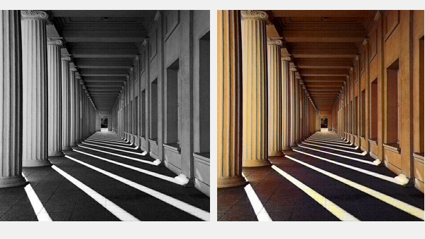
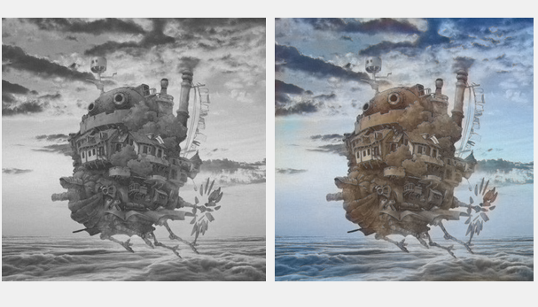
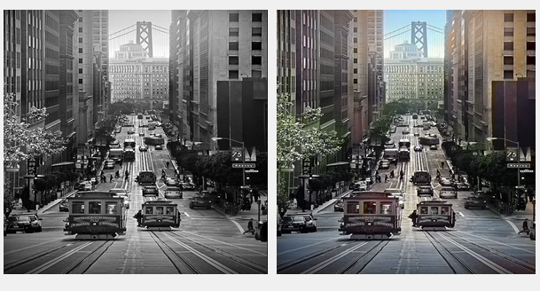
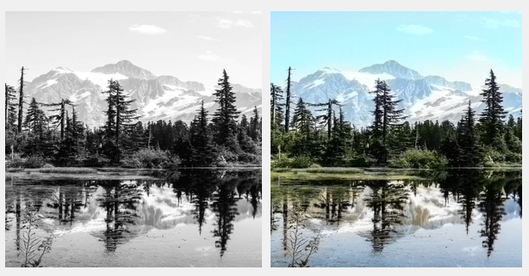
Some examples

Slide 11
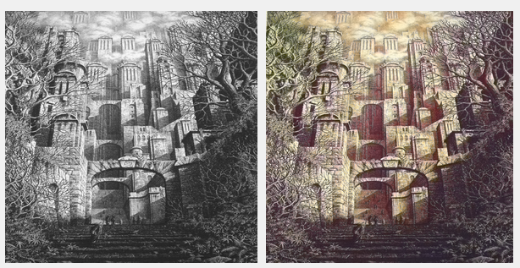
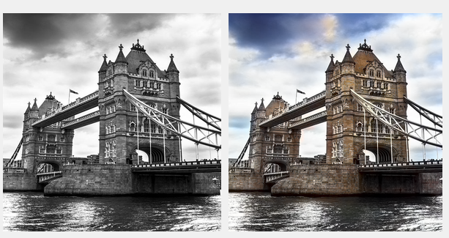
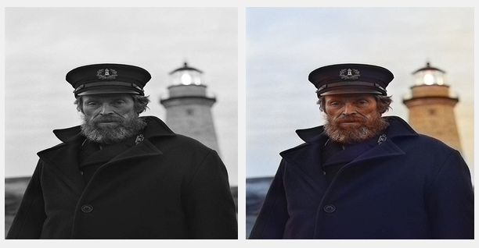
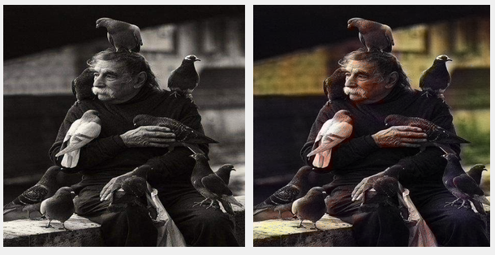
Some examples

Slide 12
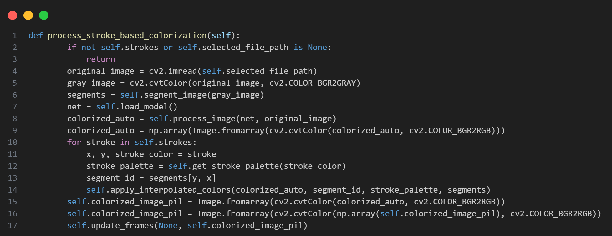
Dot colorization
The Dot-based colorization process allows users to manually add color hints to a grayscale image, which then influences the colorization result.

Slide 13
Dot colorization
Dot Data: The application allows users to draw a Dot on the grayscale image. This is associated with a specific color chosen by the user.
Identifying Unique Regions: To apply user input accurately, the image is segmented into distinct regions. This process helps in mapping user strokes to specific parts of the image, ensuring that the colors are applied precisely where the user intended..
Dot Application: For each stroke made by the user, the application identifies which segment of the image it belongs to. It then adjusts the colors of that segment according to the color specified by the user's stroke. This is done by mapping the stroke color to the Lab color space. Interpolating the stroke color across the identified segment, modifying the baseline colorization with the user's chosen colors.

Slide 14
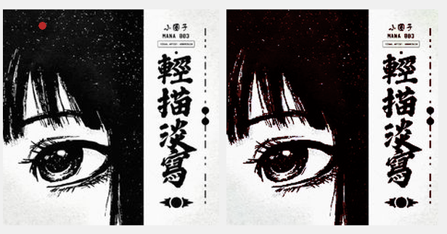
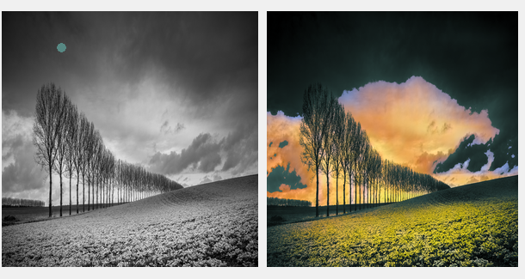
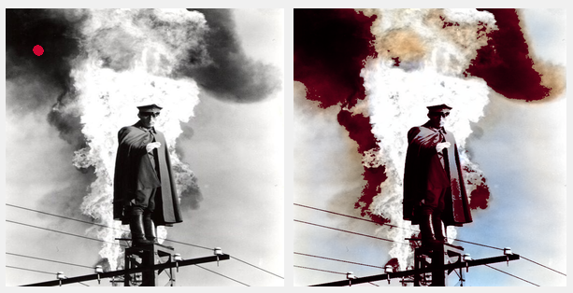
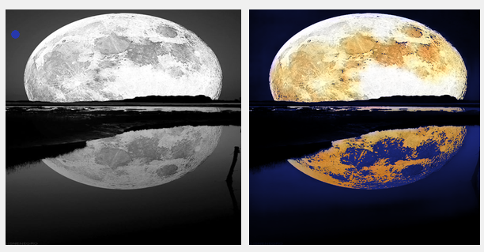
Some examples

Slide 15
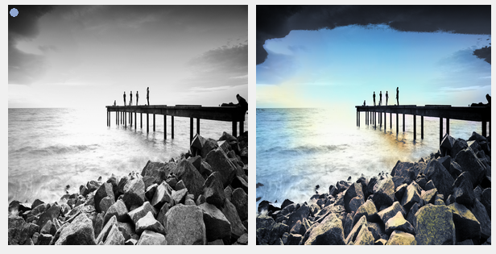
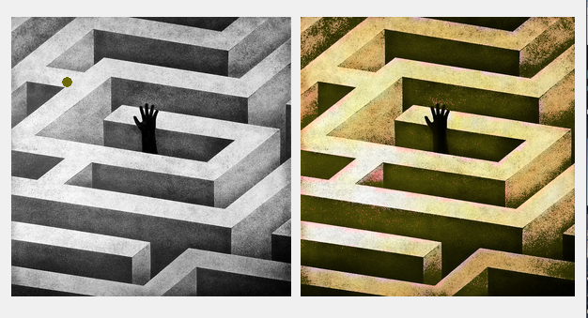
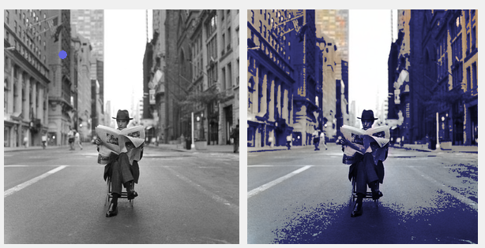
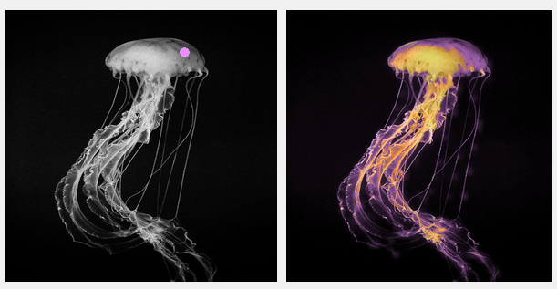
Some examples

Slide 16
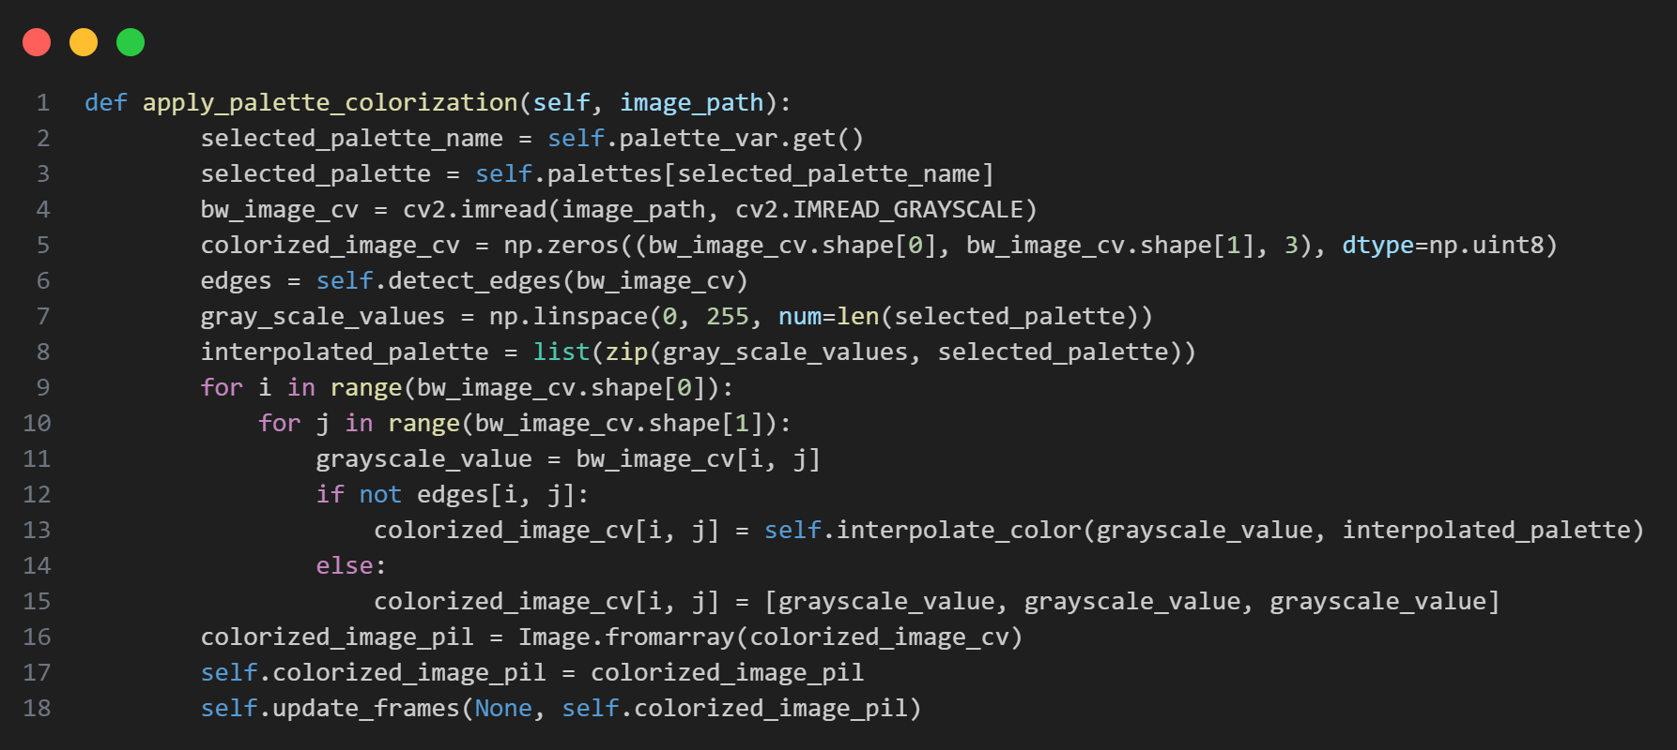
Palette colorization
Palette colorization involves coloring a grayscale image based on API fetched palettes. This method automates the colorization process by mapping the grayscale tones of the image to specific colors from the palette, providing a uniform and consistent color scheme throughout the image.

Slide 17
Palette colorization
Palette Selection and API Fetching: Utilizing the fetch_palettes method, the app retrieves color palettes from Colormind API[3], Users can select a desired palette, from 1 to 5 colors, dynamically loaded into the application from the fetched results.
Pre-processing for Colorization: A grayscale image selected by the user is read and processed. The edges of this image may be detected using the Canny edge detection algorithm to preserve details during colorization.
Palette Application: The selected color palette is mapped onto the grayscale image based on the intensity of each pixel. The apply_palette_colorization method interpolates colors from the palette across the grayscale range, assigning colors to pixels based on their luminance.
Post-processing and Display: The now colorized image is post-processed, which may involve adjusting the color balance, saturation, and brightness to ensure a natural look.The colorized image is then displayed alongside the original for comparison.

Slide 18
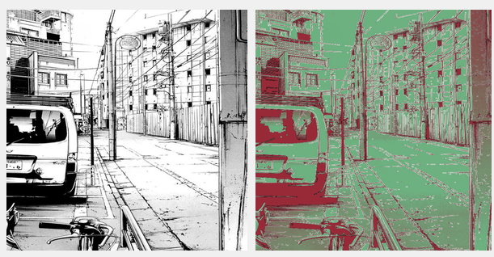
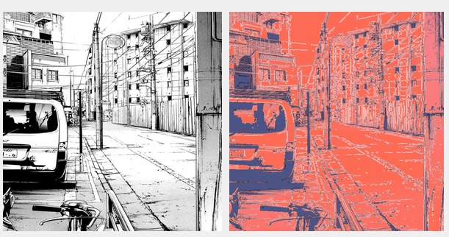
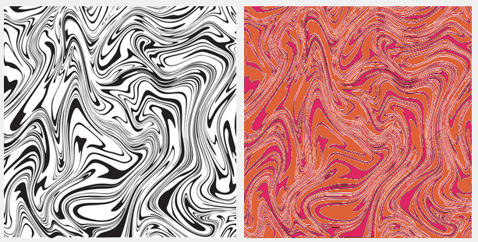


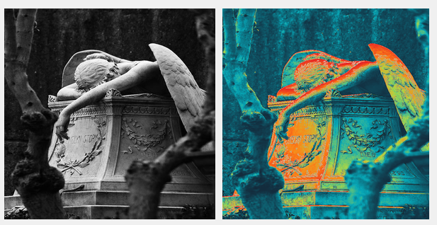
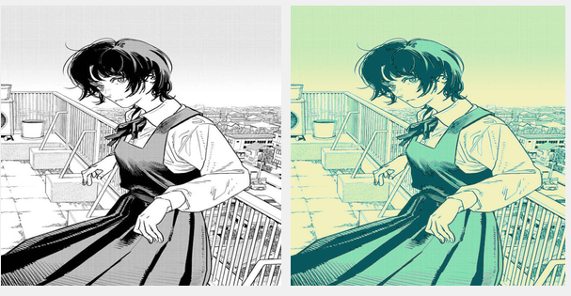
Some examples

Slide 19
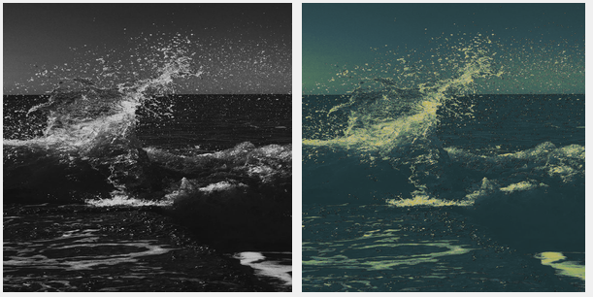
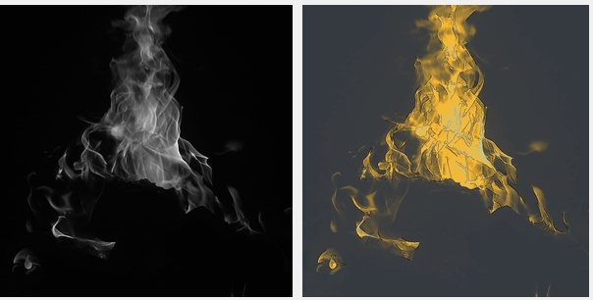
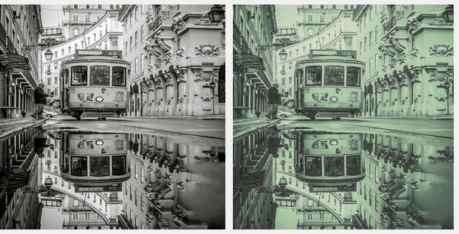
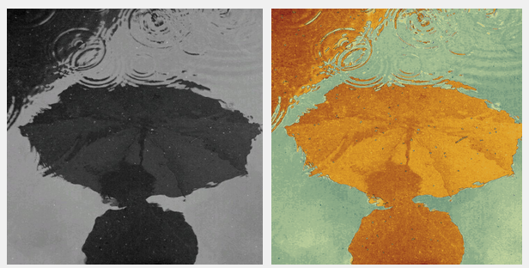
Some examples

Slide 20
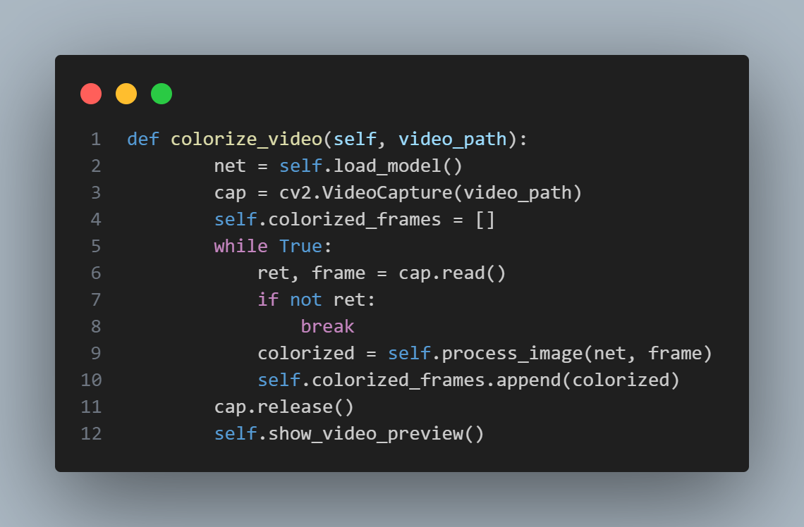
Video colorization
Video colorization follows a process that extends the automatic image colorization approach to handle sequences of frames.

Slide 21
Video colorization
Automatic Colorization of Frames: Each extracted frame undergoes the same colorization process as described for automatic image colorization. This involves using a pre-trained deep learning model to predict the chromatic channels (a* and b*) for the frame based on its luminance channel (L). The deep learning model, trained on a dataset of color images, applies learned colorization patterns to the grayscale frames, effectively predicting realistic colors for each frame.
Post-processing: Like image colorization, post-processing steps might be applied to each colorized frame to enhance visual quality. This can include adjustments to color balance, contrast, and saturation to ensure consistency across the video sequence. Edge enhancement techniques might also be used to preserve details and sharpness in the colorized frames.
Reconstruction and Output: Once all frames have been colorized and post-processed, they are recompiled back into a video format. This recompilation involves setting the correct frame rate and resolution to match the original video, ensuring that the output video retains the smooth playback of the original.

Slide 22
Some examples
Videos

Slide 23
Future remarks
Improving Dot Colorization System
Optimization and Crash Reduction
Adding New Coloring Modes
Utilizing Improved Segmentation Algorithms: Implement advanced segmentation algorithms like Mask R-CNN or U-Net for accurately identifying regions to color ser Interface for Precise Selection: Enhance the user interface with more sophisticated selection tools, such as variable-size brushes, erasers, and zoom options, to allow users to apply colors with greater accuracy.
Error Handling and Logging: Incorporate robust error handling and detailed logging systems to quickly identify and resolve crash causes.
Code Optimization: Review and optimize the code for better performance and memory efficiency, for instance, by minimizing the use of resource-intensive operations and optimizing loops.
Coloring via Text Prompt:
Implement an interface where users can input text prompts describing the desired colors for specific parts of the image, e.g., "the sky is blue, and the grass is green."
Use natural language models along with neural networks to interpret prompts and apply corresponding colors to the relevant parts of the image.

Slide 24
References
[1] https://zhexinliang.github.io/Control_Color/
[2] https://richzhang.github.io/colorization/
[3] http://colormind.io/api-access/

